Slide 1


Slide 2

Programming-→data structures-→OS

Slide 3
20MCA172 ADVANCED OPERATING SYTEMS
Prerequisite: Basic concept of desktop computer operating system

Slide 4
The purpose of an operating system is to make a system operate - basically to make the computer "work"

Slide 5
The working is not visible so why do we need to study OS ??

Slide 6
SOFTWARE CLASSIFICATION

Slide 7
OS
An operating system, or "OS," is software that communicates with the hardware and allows other programs to run.
Every desktop computer, tablet, and smartphone includes an operating system that provides basic functionality for the device.

Slide 8
The first operating system used for real work was GM-NAA I/O, produced in 1956 by General Motors' Research division^{[4]} for its IBM 704.

Slide 9
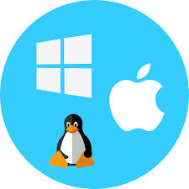
OPERATING SYSTEMS

Slide 10
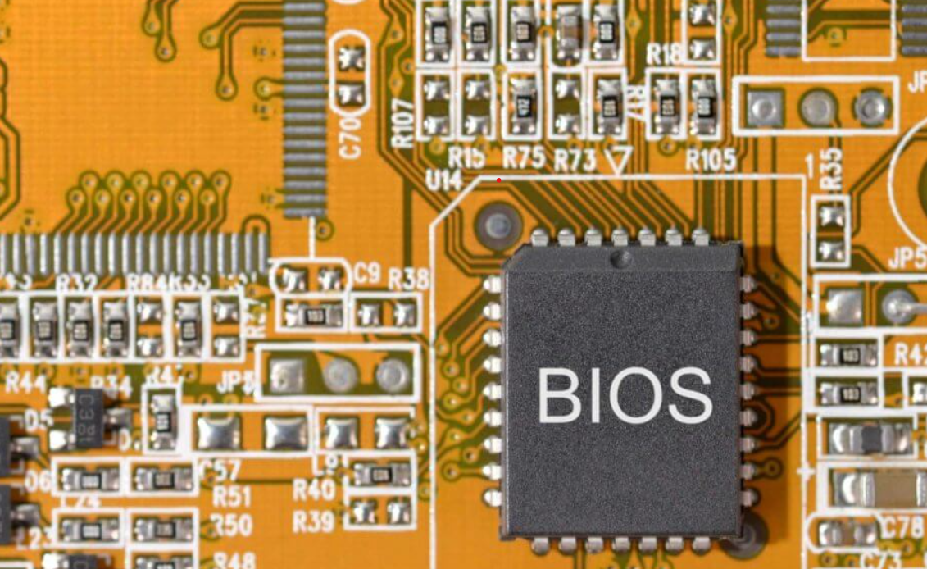
FEW POINTS ABOUT BIOS

Slide 11
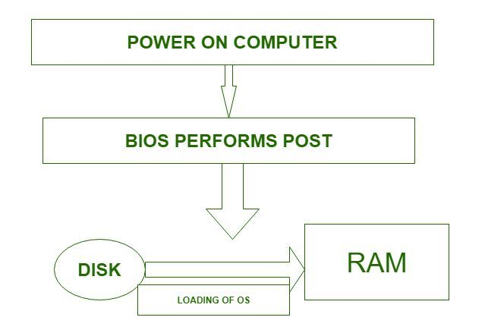
How OS is loaded into memory using only HARD DISK?
The Operating System is stored on the Hard Disk, but on boot, the BIOS will start the Operating System, which is loaded into RAM, and from that point on, the OS is accessed while it is located in your RAM.

Slide 12
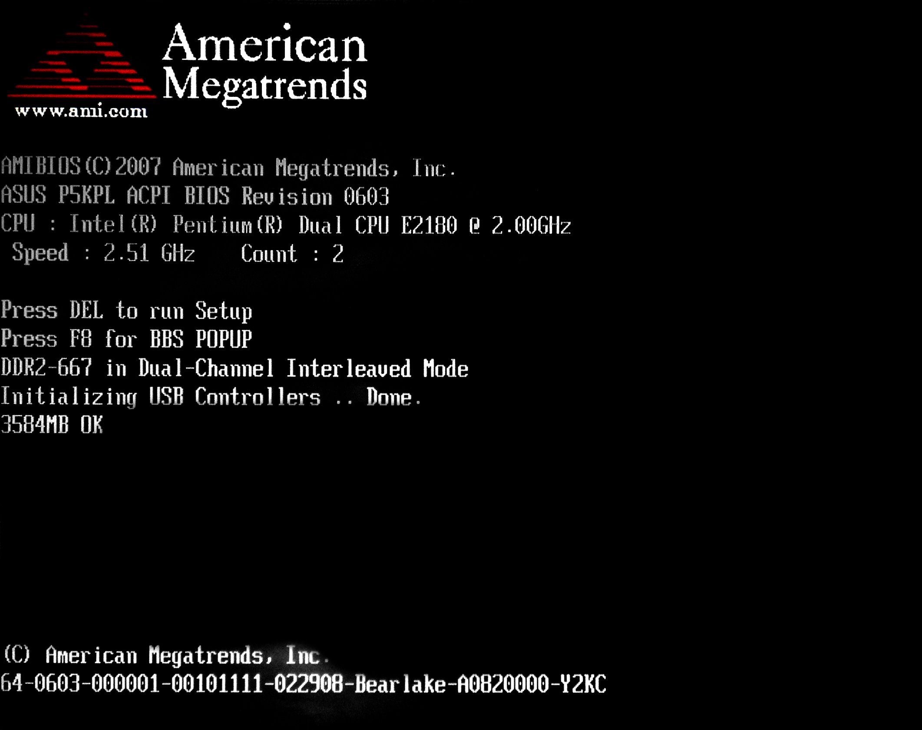
POST

Slide 13
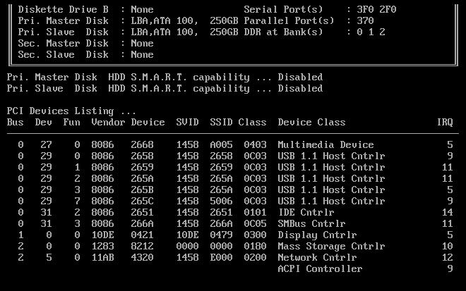

Slide 14
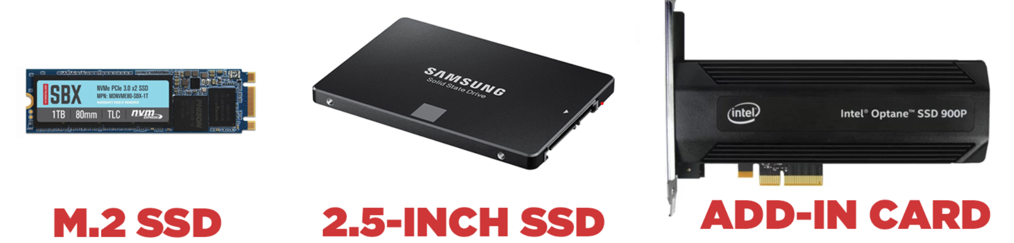
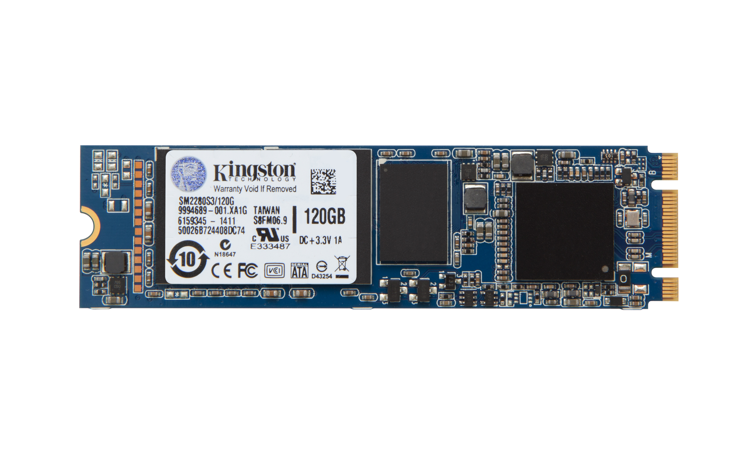
INTRODUCTION TO SSD-Solid state drive - from 20MB to 100 TB

Slide 15
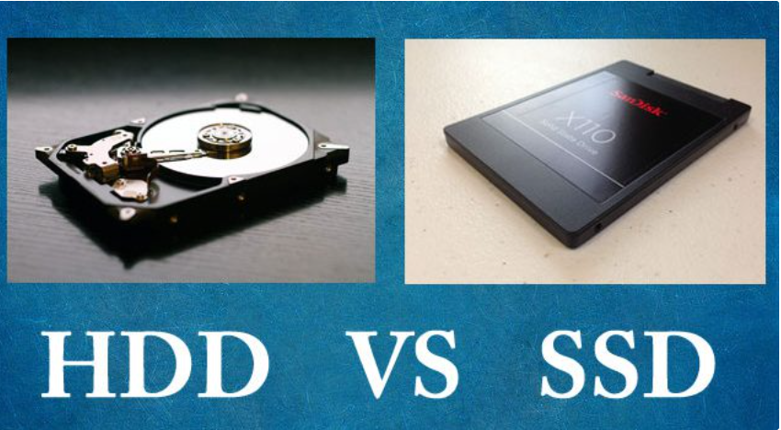
SSD – Introduced in 1991
flash memory chip
SPEED-OS LOADING
High cost
The process of running two operating systems on your PC is known as dual-booting.
When done with two separate drives, it most often involves configuring your system so that the SSD does the heavy lifting of booting and running your operating system, while the HDD is used for the less demanding task of file storage.
Press Window + R Type diskmgmt.msc

Slide 16
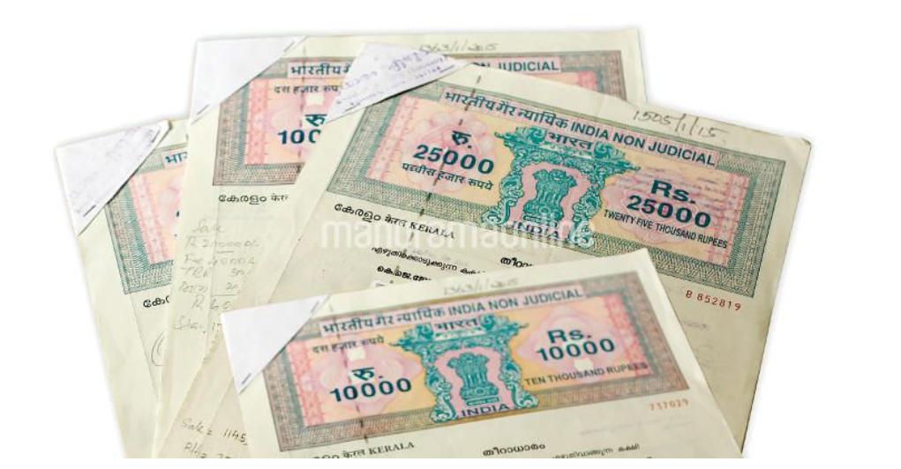

HARD DISK PARTITIONING SCHEME (Analogy:Distributing wealth)
MEMORY BOOT RECORD(MBR)
GPT( GUID PARTITION TABLE)
Seen Nowadays
GUID-GLOBAL UNIQUE IDENTIFIER

Slide 17
SET UP A NEW DISK ON WINDOWS 8.1 OR WINDOWS 10
YOU WILL BE ASKED WHETHER YOU WANT TO USE A MBR OR GPT PARTITION
MBR PARTITIONING- UPTO 4 PARTITIONS
GPT PARTITIONING-UPTO 128 PARTITIONS
GPT IS JUST WOW!!!!!!!!!!
GPT IS SEEN IN WINDOWS,LINUX ,MAC .

Slide 18
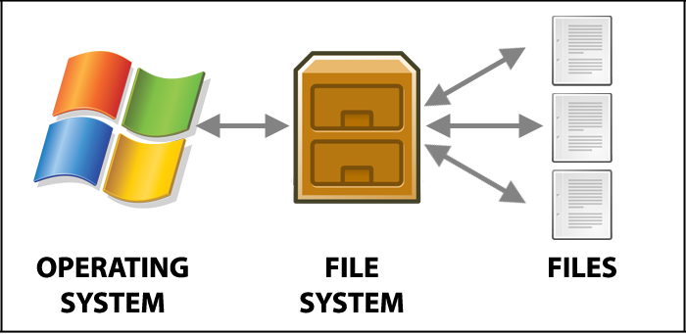
FILE SYSTEM
Controls how files are stored and retrieved

Slide 19
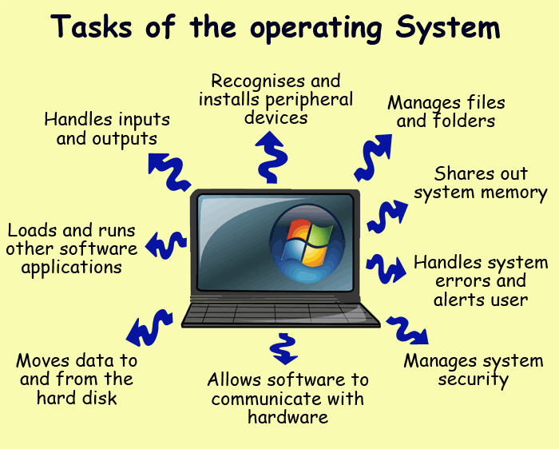

Slide 20
KEY TERMS
Synchronization
Threads
Process
Distributed systems
Multiprocessor systems
Database systems

